Slide 1
Reference Architecture for Modern Data Platforms

Slide 2

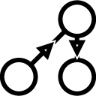





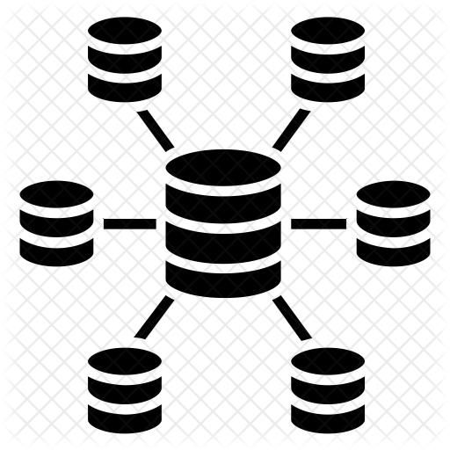












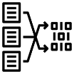
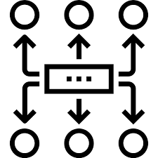




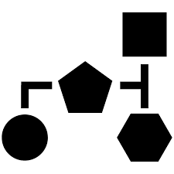











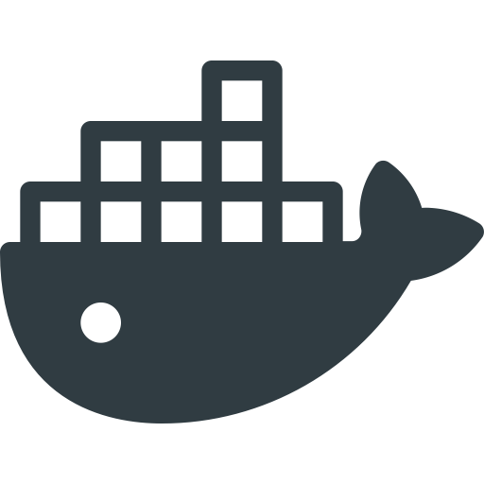
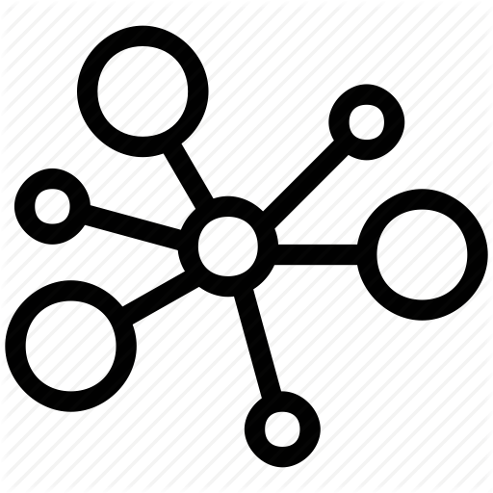




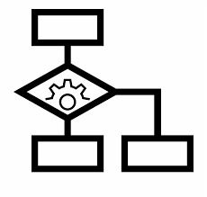

Platform Automation
Information Governance & Security
Data Sources
Modern Data Platform
Legacy
Bulk
Event Handler
Orchestration
Generator
Meta Data
Data Lineage
Data Catalog
Event Catalog
Archival
Access Mgmt
Encryption &
Protection
Artifact
Repository
File
Integration
Information Consumer / Targets
CRM
Query Virtualization
Data Lake / DWH
Warehouse
Management
DB
Extract
Sandbox
Zone
Disk Service
DFS
Object
Store
DB
Data Science Workbench
eCommerce
Shop
CDC
Usage-Opti-
Mized Zone
External
Disk
Change Data Capture
Machine Learning /
AI
Batch Data
Visualization
DFS
Object
Store
DB
DB
Refined
Zone
Query API
Mobile
Device
Data Flow
Transformation
DFS
Object
Store
DB
Streaming Data
Visualization
Service
Edge Computing
Service Bus
Landing /
Raw Zone
Object
Store
API / Service
DFS
DB
Self-Service Analytics
Robot
Stream
Message Broker
Stream Analytics
Data Flow
Wind park
Event Hub
Orchestration
Stream
Analytics
State
Models
Results
Query API
Image
Modern Apps (Microservice)
Smart City Sensor
Stream
Analytics
Event Hub
Text File
Application
Data
Materialized
Views
API
DB
Object Store
API Gateway
Market Feed
Infrastructures
Backing Services
S
Enterprise
App
Social
MediaS
Event
Message
Virtual Machine
Container
Orchestration
RDBMS /
NoSQL
Object Store
Event Store
In-Memory
Grid
Orchestration
Engine
Rules
Engine
ML Inference
Server
Bare Metal
Service Mesh
On Premises
Cloud

Slide 3

Modern Data Platform
Platform Automation
Information Governance & Security
Data Sources
M13: Orchestrating the Data Platform
M14: Automating the Data Platform
M15: Govern the Data Platform
M16: Securing the Data Platform
Legacy
Bulk
Event Handler
Orchestration
Generator
Meta Data
Data Lineage
Data Catalog
Event Catalog
Archival
Access Mgmt
Encryption &
Protection
Artifact
Repository
Integration
M10: Pushing Data to External Systems
Information Consumer / Targets
CRM
File
M12: Data Federation and Virtualization
Query Virtualization
Data Lake / DWH
Warehouse
Management
DB
Extract
Sandbox
Zone
M1: Batch Data Ingestion
DFS
Object
Store
DB
Data Science Workbench
Disk Service
M5: Analytics & Machine Learning
M3: (Big) Data Storage
eCommerce
Shop
Usage-Opti-
Mized Zone
External
Disk
Change Data Capture
Machine Learning /
AI
M11: Accessing the Data Lake
Batch Data
Visualization
M7: Invoke External System
M17: Event- / Message-Integration
DFS
Object
Store
DB
M4: (Big) Data Batch Processing
Query API
DB
Data Flow
Refined
Zone
Mobile
Device
Service
Transformation
DFS
Object
Store
DB
Streaming Data
Visualization
M2: Stream Data Ingestion
Edge Computing
Service Bus
Landing /
Raw Zone
Object
Store
API / Service
DFS
DB
Self-Service Analytics
Robot
Stream
Message Broker
Stream Analytics
M7: Invoke External System
Data Flow
M6: Stream Analytics
M8: Edge Processing
Wind park
M18: Application Integration
Event Hub
Orchestration
Stream
Analytics
State
Models
Results
Query API
Modern Apps (Microservice)
Smart City Sensor
Stream
Analytics
Event Hub
File
M9: Modern Applications (Micro- / Mini-Services)
Application
Data
Materialized
Views
API
DB
Object Store
API Gateway
Market Feed
Infrastructures
Backing Services
Enterprise
App
Social
Media
Event
Message
Virtual Machine
Container
Orchestration
RDBMS /
NoSQL
Object Store
Event Store
In-Memory
Grid
Orchestration
Engine
Rules
Engine
ML Inference
Server
Bare Metal
Service Mesh
Cloud
On Premises

Slide 4
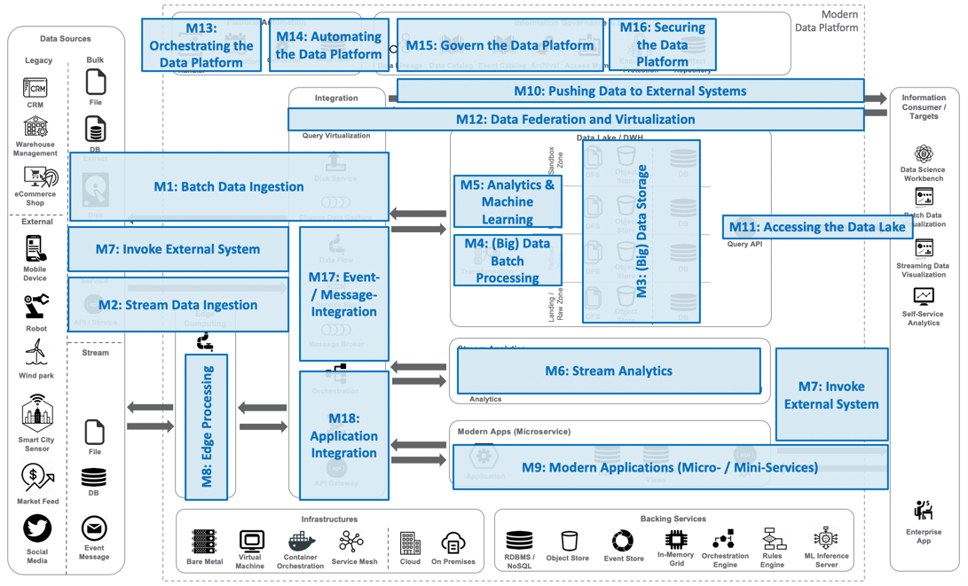

Slide 5
“Trivadis
Data Platform” - Tech Mappings
Notes:
Scenario ist hier nicht der gute Begriff, ist mir auf die schnelle nichts anderes in den Sinn gekommen.

Slide 6
Modern Data Platform
Licensed
Open Source
Platform Automation
Information Governance & Security
Data Sources
Kafka Connect
Amundsen
StreamSets
Airflow
Trivadis biGENiUS
Apache Atlas
Apache Ranger
Legacy
Bulk
Event Handler
Orchestration
Generator
Meta Data
Data Lineage
Data Catalog
Event Catalog
Archival
Access Mgmt
Encryption &
Protection
Artifact
Repository
Fn Project
File
Integration
Information Consumer / Targets
CRM
Debezium
Data Lake / DWH
Warehouse
Management
Disk Service
Cassandra
Oracle RDBMS
DB
Extract
StreamSets
Sandbox
Zone
HDFS
MinIO
Elasticsearch
RStudio
Attunity
Neo4J
Zeppelin
Change Data Capture
DFS
Object
Store
DB
Data Science Workbench
eCommerce
Shop
Presto
H2O.ai
Cassandra
Cubeware Cockpit
Spark
Usage-Opti-
Mized Zone
HDFS
MinIO
Elasticsearch
Arcadia Data
Disk
Starburst Data
Machine Learning /
AI
Batch Data
Visualization
External
Query Virtualization
Object
Store
Neo4J
Hive
DFS
DB
Power BI
Kafka Connect
Map/Reduce
Cassandra
Query API
DB
StreamSets
Refined
Zone
HDFS
MinIO
Elasticsearch
Arcadia Data
Data Flow
Spark
Object
Store
DB
Streaming Data
Visualization
Mobile
Device
Service
Transformation
DFS
Neo4J
Power BI
HDFS
MinIO
Cassandra
Edge Computing
Orchestration
Landing /
Raw Zone
Object
Store
Elasticsearch
DFS
Neo4J
Self-Service Analytics
Robot
API / Service
DB
Stream
Camel
Stream Analytics
Data Flow
Service Bus
Kafka Streams
Cassandra
Wind park
MQTT
Active MQ
Elasticsearch
RabbitMQ
State
Neo4J
Stream
Analytics
Models
Results
Query API
Event Hub
Message Broker
Spring Boot
Kafka REST Proxy
Kafka
Modern Apps (Microservice)
Smart City Sensor
Stream
Analytics
Event Hub
Quarkus
Fn Project
Cassandra
File
Micronaut
Helidon
Elasticsearch
Kong
Neo4J
Materialized
Views
Spring Boot
Data
API
Object Store
API Gateway
Application
Market Feed
DB
Infrastructures
Backing Services
TensorFlow Serving
Kubernetes
Istio
MinIO
AxonIQ
Redis
Zeebe
Deep Detect
Enterprise
App
Social
Media
Event
Message
Virtual Machine
Docker
RDBMS /
NoSQL
In-Memory
Grid
Orchestration
Engine
Rules
Engine
ML Inference
Server
Bare Metal
Container
Orchestration
Service Mesh
Cloud
On Premises
Object Store
Event Store

Slide 7
Modern Data Platform
PasS
Serverless
Platform Automation
Information Governance & Security
IaaS
Container
Data Sources
Step Functions
Amundsen
Trivadis BiGENiUS
Apache Atlas
IAM
Legacy
Bulk
Lambda
Generator
Meta Data
Glue Data Catalog
API Management
Encryption &
Protection
Artifact
Repository
Event Handler
Orchestration
Data Lineage
Data Catalog
Event Catalog
Archival
Access Mgmt
File
Integration
Information Consumer / Targets
CRM
Data Sync
Transfer for SFTP
Comprehend
Databricks on AWS
Disk Service
Data Lake / DWH
Warehouse
Management
Rekognition
RDS / Aurora
Redshift
RStudio on EMR
DB
Extract
StreamSets
Data Collector
Textract
Sandbox
Zone
Dynamo DB
Redshift
Spectrum
RStudio
Databricks on AWS
Neptune
Zeppelin on EMR
Data Sync
Change Data Capture
SageMaker
DFS
Object
Store
DB
Data Science Workbench
Athena
Timestream
JupyterHub on EMR
eCommerce
Shop
Snowball
Deep Learning
Containers
HBase on EMR
QuickSight
Presto on EMR
Machine Learning /
AI
Usage-Opti-
Mized Zone
Arcadia Data
External
Disk
Query Virtualization
S3
Batch Data
Visualization
StreamSets
Data Collector
DFS
Object
Store
DB
API Gateway
StreamSets
Data Collector
S3
Query API
DB
Glue
Refined
Zone
S3 IA
Arcadia Data
Data Flow
Glue
Object
Store
Streaming Data
Visualization
Mobile
Device
Service
Kinesis Data Streams
Transformation
DFS
DB
Batch
S3
Spark on EMR
Landing /
Raw Zone
QuickSight
Edge Computing
Orchestration
S3 Glacier
S3 Glacier
Deep Archive
API / Service
StreamSets
Data Collector
DFS
Object
Store
DB
Self-Service Analytics
Robot
StreamSets
Data Collector Edge
Stream Analytics
Stream
Data Flow
Service Bus
Spark Streaming on EMR
DynamoDB
Databricks on AWS
Elasticsearch
API Gateway
Wind park
MQTT
Kinesis Data Analytics
Timestream
Kafka Streams/
KSQL
State
Models
Results
Query API
Event Hub
Message Broker
Stream
Analytics
Neptune
IoT Greengrass
Managed Streaming for Kafka
Lambda@Edge
Kinesis Data Firehose
Modern Apps (Microservice)
Smart City Sensor
Stream
Analytics
Event Hub
Lambda
Dynamo DB
File
Confluent Cloud
Elasticsearch
API Gateway
API Gateway
Batch
Timestream
Spring Boot
Data
Materialized
Views
API
Object Store
API Gateway
Application
Neptune
Market Feed
DB
Infrastructures
Backing Services
StreamSets
Data Collector
Kubernetes (EKS)
Enterprise
App
Event
Message
Fargate
Social
Media
Snowball
Edge
Virtual Machine
Container
Orchestration
RDBMS /
NoSQL
Object Store
Event Store
In-Memory
Grid
Orchestration
Engine
Rules
Engine
ML Inference
Server
Bare Metal
Service Mesh
Cloud
On Premises

Slide 8
Modern Data Platform
PaaS
Serverless
Platform Automation
Information Governance & Security
IaaS
Container
Data Sources
Functions
Collibra / Alation
Storage
Blob
Active Directory
Key Vault
Container Registry
Legacy
Bulk
Event Grid
Airflow
Trivadis biGENiUS
Data Catalog
Event Handler
Orchestration
Generator
Meta Data
Data Lineage
Data Catalog
Event Catalog
Archival
Security Center
Encryption &
Protection
Artifact
Repository
Access Mgmt
Import / Export
Integration
Information Consumer / Targets
CRM
File
Data Box Disk
Data Box
Zeppelin
Data Box Heavy
HD Insight Spark
Data Lake / DWH
Warehouse
Management
Disk Service
Cosmos DB
SQL Database
Jupyter
DB
Extract
Attunity Replicate
Databricks on Azure
Sandbox
Zone
Storage Blob
SAP HANA
SQL Data Warehouse
Machine Learning Studio
Debezium
Machine Learning
Data Lake Store
Timeseries
Insights
Data Science Workbench
Change Data Capture
DFS
Object
Store
DB
Databricks on Azure
eCommerce
Shop
HD Insight IQ
Batch AI
Storage Blob
Cosmos DB
Power BI
Spark vML
Usage-Opti-
Mized Zone
SQL Database
External
Disk
Query Virtualization
Machine Learning /
AI
Data Lake Store
API Management
Batch Data
Visualization
Object
Store
SQL Data Warehouse
StreamSets
Data Collector
Data Lake Analytics
DFS
DB
Refined
Zone
Storage Blob
Cosmos DB
Query API
Power BI
DB
Data Factory
Databricks on Azure
SQL Database
Data Flow
Data Lake Store
ArcadiaData
Mobile
Device
Transformation
DFS
Object
Store
DB
Streaming Data
Visualization
Service
Spark
SQL Data Warehouse
Data Box Edge
Logic Apps
Landing /
Raw Zone
Storage Blob
Cosmos DB
Power BI
Edge Computing
Orchestration
Data Lake Store
SQL Database
Data Box Gateway
DFS
Object
Store
DB
Self-Service Analytics
Robot
API / Service
IoT Suite
SQL Data Warehouse
Stream
StreamSets
Data Collector
Service Bus
Stream Analytics
Data Flow
Service Bus
Stream Analysis
Event Grid
Cosmos DB
API Management
Wind park
MQTT
Kafka Streams/
KSQL
Cache for Redis
Event Hub
Message Broker
Stream
Analytics
State
Models
Results
Query API
HD Insight Kafka
Confluent
Modern Apps (Microservice)
Stream
Analytics
Event Hub
Smart City Sensor
Event Hub
Functions
Cosmos DB
API Management
File
Blob Storage
IoT Edge
IoT Hub
API Apps
Cache for Redis
SQL Database
API Management
.NET
Data
Materialized
Views
API
Object Store
API Gateway
Application
Market Feed
DB
IoT Edge
Infrastructures
Backing Services
TensorFlow Serving
Kubernetes Service
Azure
Cosmos DB
Storage Blob
Logic Apps
Deep Detect
Enterprise
App
Social
Media
Event
Message
Container Instances
Cache for Redis
In-Memory
Grid
Orchestration
Engine
Rules
Engine
ML Inference
Server
Bare Metal
Virtual Machine
Container
Orchestration
Service Mesh
Cloud
On Premises
RDBMS /
NoSQL
Object Store
Event Store

Slide 9
Modern Data Platform
Platform Automation
Information Governance & Security
Data Sources
Functions
Collibra / Alation
Identity and Access Management
Key Management
Container Registry
Legacy
Bulk
Events Service
Meta Data
Data Catalog
Identity Cloud Service
Event Handler
Orchestration
Generator
Data Lineage
Data Catalog
Event Catalog
Archival
Access Mgmt
Encryption &
Protection
Artifact
Repository
File
Integration
Information Consumer / Targets
CRM
Transfer Service
Disk Service
Data Lake / DWH
Zeppelin
Warehouse
Management
DB
Extract
StreamSets
Data Collector
Object Storage
Autonomous DWH
GoldenGate Cloud Service
Sandbox
Zone
NoSQL DB
Jupyter
Change Data Capture
Archive Storage
Data Science Workbench
DFS
Object
Store
DB
Data Science
eCommerce
Shop
Big Data SQL Cloud Service
Machine Learning
Data Science
Usage-Opti-
Mized Zone
Object Storage
Visual Builder
External
Disk
Query Virtualization
Machine Learning /
AI
Archive Storage
Batch Data
Visualization
Oracle Data Integrator
DFS
Object
Store
DB
API Platform
DB
StreamSets
Data Collector
Big Data Cloud Service
Refined
Zone
Object Storage
Query API
Data Flow
Archive Storage
Streaming Data
Visualization
Mobile
Device
Service
Transformation
DFS
Object
Store
DB
Process Cloud Service
Landing /
Raw Zone
Object Storage
Edge Computing
Orchestration
Archive Storage
API / Service
DFS
Object
Store
DB
Self-Service Analytics
Robot
StreamSets
Data Collector (Edge)
Stream
SOA Cloud Service
Stream Analytics
Data Flow
Service Bus
Kafka Streams/
KSQL
Autonomous Transaction Proc
Wind park
MQTT
Messaging
NoSQL DB
Event Hub
Notifications
Stream
Analytics
State
Models
Results
Query API
Message Broker
Attunity Replicate
Streaming
Modern Apps (Microservice)
Stream
Analytics
Confluent
Smart City Sensor
Debezium
Event Hub
Functions
Autonomous Transaction Proc
File
API Platform
Java
NoSQL DB
Materialized
Views
Object Store
API Gateway
Application
Data
API
Market Feed
DB
Infrastructures
Backing Services
StreamSets
Data Collector
Container Engine for Kubernetes
Autonomous Transaction Proc
GraphPipe
Enterprise
App
Social
Media
Event
Message
Container Pipelines
NoSQL DB
Object Storage
In-Memory
Grid
StreamSets
Data Collector Edge
Virtual Machine
Container
Orchestration
RDBMS /
NoSQL
Object Store
Event Store
Orchestration
Engine
Rules
Engine
ML Inference
Server
Bare Metal
Service Mesh
Cloud
On Premises
Autonomous DWH
Archive Storage

Slide 10
Modern Apps
Notes:
Scenario ist hier nicht der gute Begriff, ist mir auf die schnelle nichts anderes in den Sinn gekommen.

Slide 11


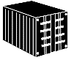


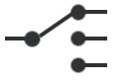
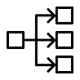
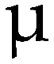





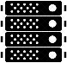

Governance & Security
Identity
Provider
Security
Token
Policy Mgmt
Encryption
Service
Registry
Event Catalog
API Catalog
Artifact
Repository
Container Registry
Apps
API
Modern Applications
Backing Services
Service Mesh
Container Platform
Mobile App
API Gateway
RDBMS
NoSQL
In-Memory
Grid
Service
Discovery
Configuration Store
Microservice A
Browser App
Messaging
Object Store
Data Flow
Event Store
Traffic
Router
Load
Balancer
Miniservice B
Other Service
Orchestration
Engine
Rules
Engine
ML Inference
Engine
Event Hub
Health
Checking
Container
Orchestration
Observability
Enterprise Apps
Automation
Telemetry
Micro Architecture
Build
Automation
Test
Automation
Deployment
Automation
Platform
Automation
Diagnostics
Monitoring
Macro Architecture

Slide 12


Data Sources
Modern Data
Platform
API
Data Lake / DWH
Legacy
Bulk
Sandbox
Zone
DFS
Object
Store
DB
CRM
Disk Service
Machine Learning /
AI
Usage-Opti-
Mized Zone
File
DFS
Object
Store
DB
Warehouse
Management
Change Data Capture
Query API
DB
Extract
Refined
Zone
Transformation
DFS
Object
Store
DB
Telemetry
eCommerce
Shop
Query Virtualization
Landing /
Raw Zone
External
DFS
Object
Store
DB
Diagnostics
Monitoring
Disk
Email
Governance & Security Automation
Service
Data Flow
Mobile
Device
Data Lineage
Data Catalog
Event Catalog
Policy Mgmt
Encryption
Platform
Automation
Artifact
Generator
API / Service
Apps
Messaging
Stream
Service
Registry
Artifact
Repository
API Catalog
Identity
Provider
Security
Token
Build
Automation
Test
Automation
Deployment
Automation
Robot
Data Science
Lab
Streaming Data
Visualization
Event Hub
Wind park
Service Mesh Runtime Platform
Backing Services
Event
Message
Batch Data
Visualization
Self-Service Analytics
Orchestration
Service
Discovery
Configuration Store
RDBMS
NoSQL
In-Memory
Grid
Smart City Sensor
Microservice A
DB
Mobile App
Browser App
Service Bus
Traffic
Router
Load
Balancer
Object Store
Data Flow
Event Store
Microservice B
Market Feed
File
Health
Checking
Container
Orchestration
Orchestration
Engine
Rules
Engine
ML Inference
Server
Other Service
API Gateway
Observability
Social
Media

